Slide 1
Virtual function
&
Run time polymorphism
Notes:
One name, multiple forms.polymorphism is implemented by fn overloading , oprtr overloading, fn is selected by matching type and no.of arguments., done at compile time, early/ static binding. If memb fn is selected while pgm is running->run time polymorphism. Virtual fn is used to achieve run time polymorphism.

Slide 2
One name, multiple forms. polymorphism is implemented by fn overloading , oprtr overloading, fn is selected by matching type and no.of arguments., done at compile time, early/ static binding.
If memb fn is selected while pgm is running->run time polymorphism. Virtual fn is used to achieve run time polymorphism.

Slide 3
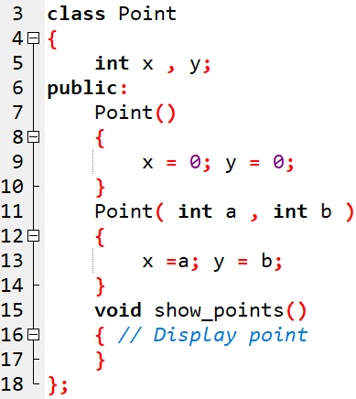
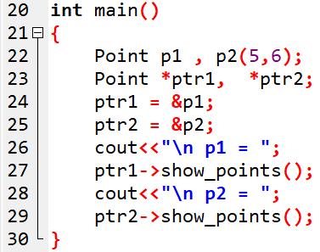

Pointer to object: Example-1

Slide 4
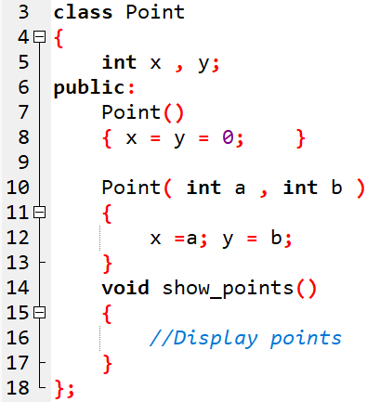
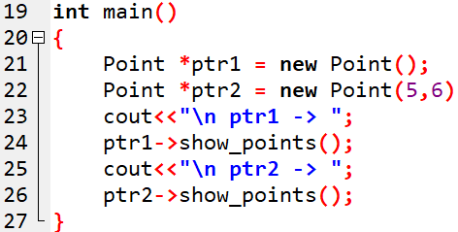

Pointer to object: Example-2

Slide 5
We can use base class ptr to refer to all derv class objects, but it always exe the fn of in base class.
To achieve polymorphism, use virtual fn in base.
When a fn is made virtual, c++ determines which fn to to use at runtime based on type of object pointed to by base pointer rather than type of pointer. Thus , by making the base ptr point to diff objects , we can exe diff versions of virtual fns.

Slide 6
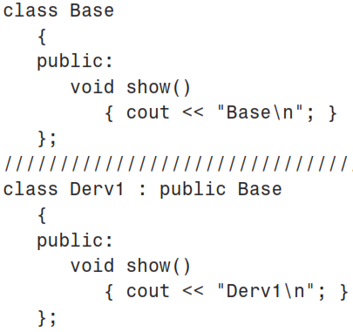
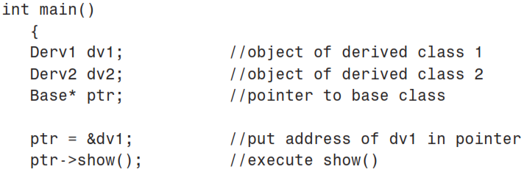
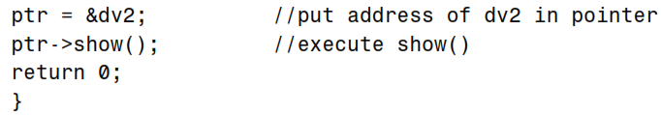
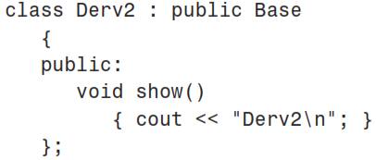

Time to think!
What happens to overrridden functions accessed by base class pointer?
OUTPUT
Notes:
ae can use base class ptr to refer to all derv class objects, but it always exe the fn of in base class. To achieve polymorphism, use virtual fn in base. When a fn is made virtual, c++ determines which fn to to use at runtime based on type of object pointed to by base pointer rather than type of pointer. Thus , by making the base ptr point to diff objects , we can exe diff versions of virtual fns.

Slide 7
We can use base class ptr to refer to all derived class objects, but it always execute the function of in base class.
To achieve polymorphism, use virtual function in base.
When a function is made virtual, c++ determines which function to use at runtime based on type of object pointed to by base pointer rather than type of pointer.
Thus , by making the base ptr point to different objects , we can execute different versions of virtual function.

Slide 8
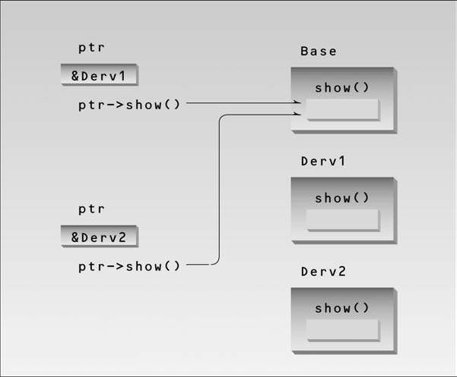

Slide 9
A virtual function is a member function that is declared in the base class using the keyword virtual and is re-defined (Overridden) in the derived class. It tells the compiler to perform late binding where the compiler matches the object with the right called function and executes it during the runtime. This technique falls under Runtime Polymorphism.
The term Polymorphism means the ability to take many forms. It occurs if there is a hierarchy of classes that are all related to each other by inheritance.
Consider the following simple program as an example of runtime polymorphism. The main thing to note about the program is that the derived class’s function is called using a base class pointer.
The idea is that virtual functions are called according to the type of the object instance pointed to or referenced, not according to the type of the pointer or reference.
In other words, virtual functions are resolved late, at runtime.

Slide 10
Runtime polymorphism is the process of binding an object at runtime.
Overriding methods is one way to implement runtime polymorphism.
At runtime, not at compilation time, the C++ decides which method to invoke.
Also known as dynamic binding or late binding.
The parent class's method is overridden in the child class, according to this concept.
The term "method overriding" refers to the situation where a child class implements a method specifically that was supplied by one of its parent classes.
Notes:
https://www.javatpoint.com/virtual-functions-and-runtime-polymorphism

Slide 11
Polymorphism, means "showing different characteristics in a variety of situations"
To achieve Runtime Polymorphism, virtual functions are primarily used.
Only a base class type pointer (or reference) can enable runtime polymorphism.
A base class pointer can also point to both objects from the base class and those from derived classes.

Slide 12
Virtual functions and runtime polymorphism
A member function that has the keyword virtual used in its declaration in the base class and is redefined (Overridden) in the derived class is referred to as a virtual function.
The late binding instruction instructs the compiler to execute the called function during runtime by matching the object with the appropriately called function. This technique is called as Runtime Polymorphism.

Slide 13
Virtual functions and runtime polymorphism
A member function that has the keyword virtual used in its declaration in the base class and is redefined (Overridden) in the derived class is referred to as a virtual function. The late binding instruction instructs the compiler to execute the called function during runtime by matching the object with the appropriately called function. Runtime Polymorphism refers to this method.
Polymorphism, which is defined as "showing diverse traits in different contexts," can be summarised as "showing different characteristics in a variety of situations" and "polymorphism."
What is the use of virtual functions?
To achieve Runtime Polymorphism, virtual functions are primarily used. Only a base class type pointer (or reference) can enable runtime polymorphism. A base class pointer can also point to both objects from the base class and those from derived classes.
Also, without even knowing the type of derived class object, we can use virtual functions to compile a list of base class pointers and call any of the derived classes' methods.

Slide 14
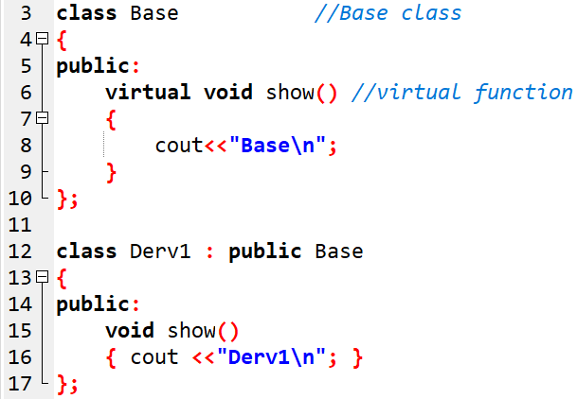
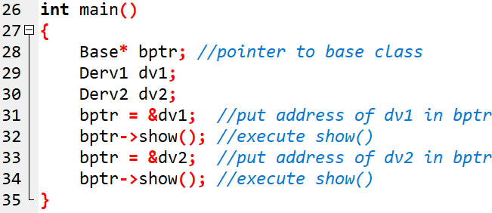
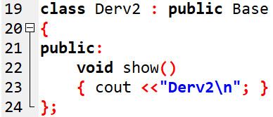

Virtual function and Run-Time polymorphism:

Slide 15
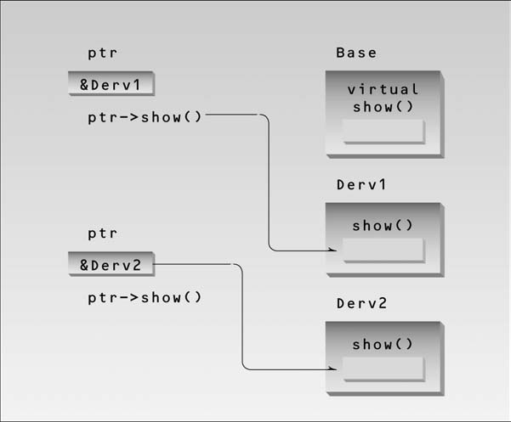

Slide 16
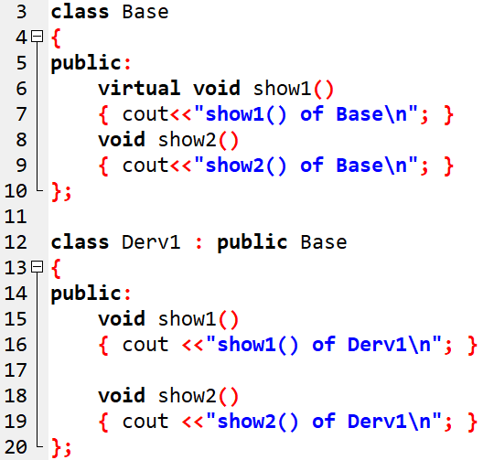
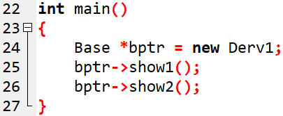

Question-1:
Notes:
Show2 fn is not virtual, show1 is virtual

Slide 17
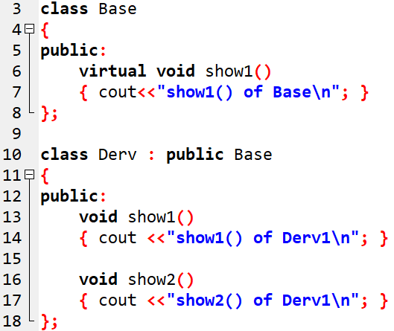
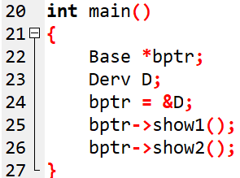

Time to think!
What happens to non-overrridden functions accessed by base class pointer?
Only the inherited features are accessible through base class pointer

Slide 18
Abstract class.
When we will never want to instantiate objects of a base class, we call it an abstract class.
Such a class exists only to act as a parent of derived classes that will be used to instantiate objects.
By placing at least one pure virtual function in the base class.
A pure virtual function is one with the expression =0 added to the
declaration.
Eg:- virtual void show() = 0; // pure virtual function
Notes:
Designed to act as base class for all derv classes.it is a design concept in pgm devlt , provides a base upon which all other classes are built.
It may also provide an interface for the class hierarchy. ,,acts as a placeholder. Does’nt do any task. A class containing pure virtual function cannot be used to declare any objects of its own. Such classes are called abstract classes.

Slide 19
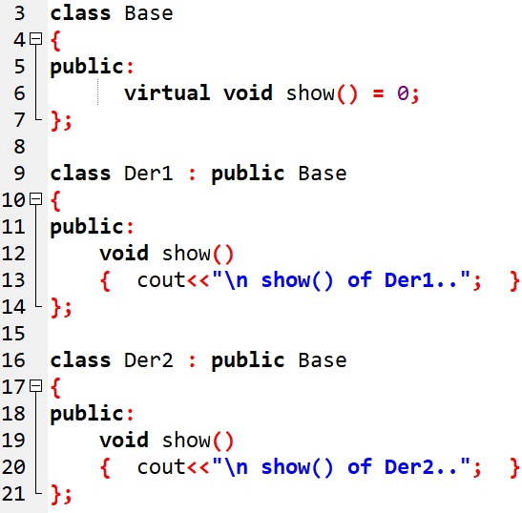
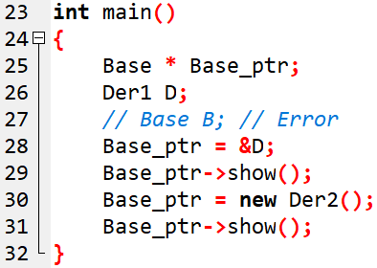

Pure virtual function & abstract class
Notes:
virtual void show() = 0; // pure virtual function
The equal sign here has nothing to do with assignment; the value 0 is not assigned to anything.
The =0 syntax is simply how we tell the compiler that a virtual function will be pure.

Slide 20
Representing Shapes
shape
inherits (isa)
rectangle
• • • •
triangle
circle
square

Slide 21
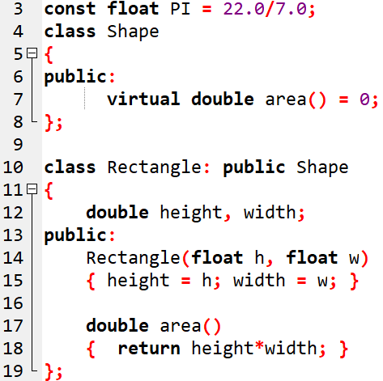
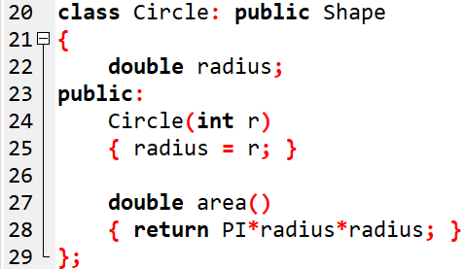

Slide 22
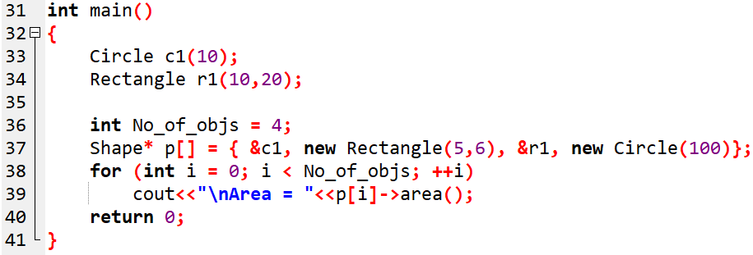

Each element of the array is an address of derived class object
OUTPUT:

Slide 23
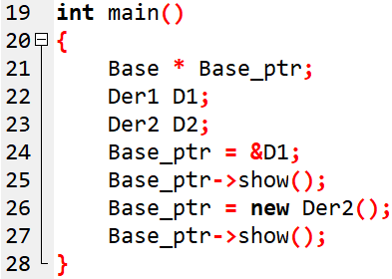
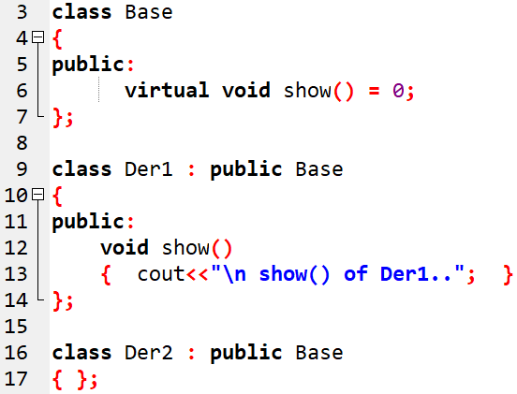
Question:
//ERROR
//ERROR
Der2 also becomes an abstract class, not instantiable

Slide 24
Destructors
Base class destructors should always be virtual.
Suppose you use delete with a base class pointer to a derived class object to destroy the derived-class object.
  If the base-class destructor is not virtual then delete, like a normal member function, calls the destructor for the base class, not the destructor for the derived class.
This will cause only the base part of the object to be destroyed.

Slide 25
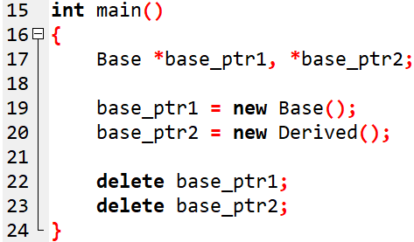
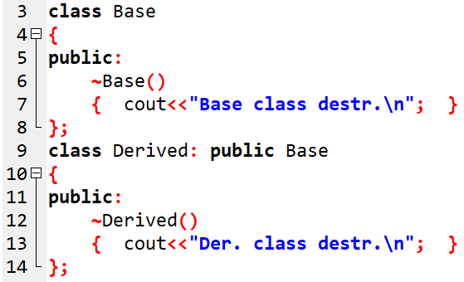

Without Virtual destructor
OUTPUT:

Slide 26
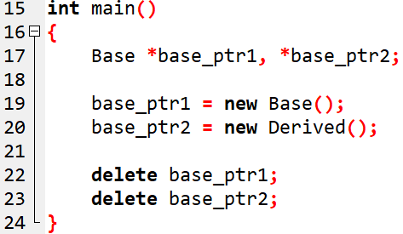
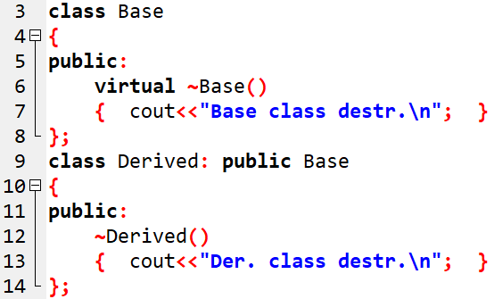

With Virtual destructor
OUTPUT:

Slide 27
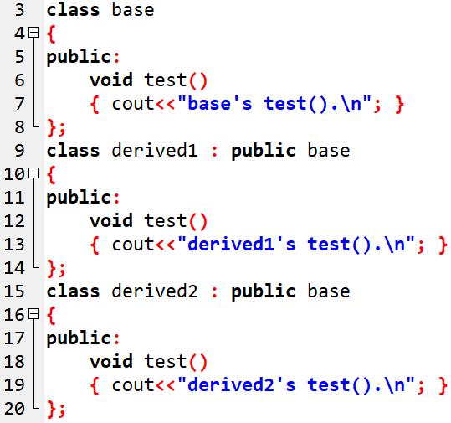
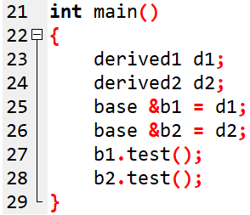

base class reference without virtual function
OUTPUT

Slide 28
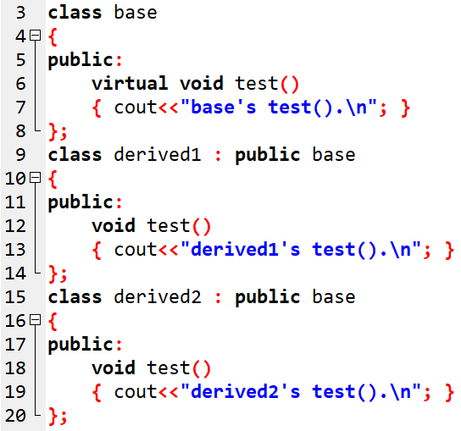
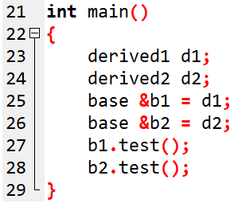

base class reference with virtual function
OUTPUT

Slide 29
Some topics on Pointers…

Slide 30
Pointers and structures
Consider the following structure
struct inventory
{
char name[30];
int number;
float price;
} product[2], *p;
p=product; assigns the address of the zeroth element of product to p
or p points to product[0];

Slide 31
Pointers and structures (Contd…)
Its members are accessed using the following notation
p->name
p->number
p->price
The symbol -> is called arrow operator (also known as member selection operator)
The member number can also be accessed using
(*p).number
Parantheses is required because ‘.’ has higher precedence than the operator *

Slide 32
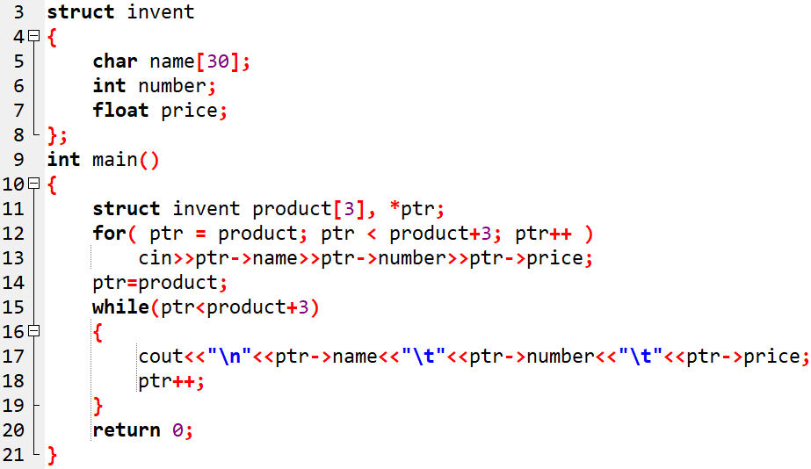
Program to illustrate the use of structure pointers

Slide 33
CONSTANT POINTERS..
1. Pointer to constant
2. Constant pointer, non-constant data
3. Constant pointer, constant data

Slide 34
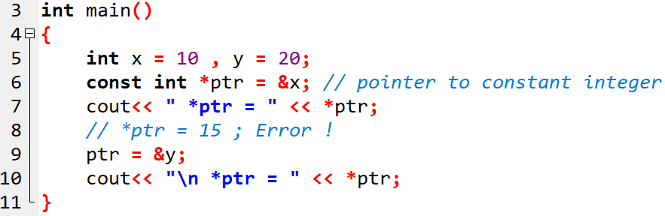

1. Pointer to constant
const datatype * ptr;
The value pointed by the pointer cannot be changed, but the pointer can be changed.
OUTPUT

Slide 35
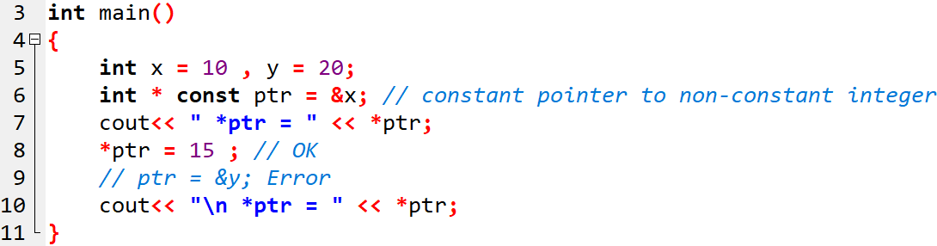

2. Constant pointer, non-constant data
int * const ptr;
It creates a constant pointer to a non-constant integer.
The value pointed by the pointer can be changed, but the pointer cannot be changed.
OUTPUT

Slide 36
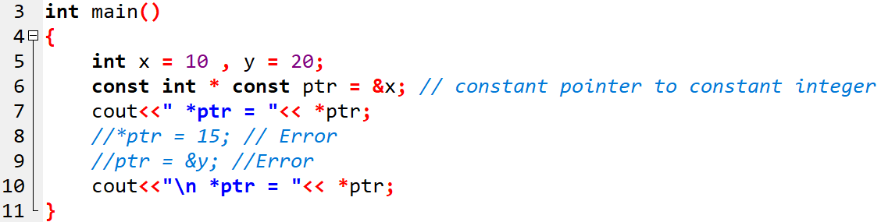
3. Constant pointer, constant data
const int * const ptr;
It creates a constant pointer to a constant integer.
The value pointed by the pointer cannot be changed, also the pointer cannot be changed.

Slide 37
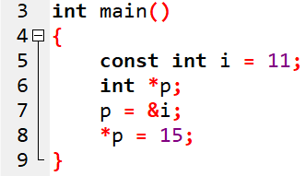
Question-1
Error !

Slide 38
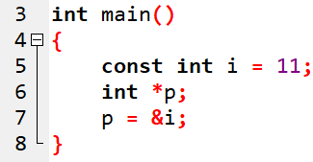
Question-2
Error !

Slide 39
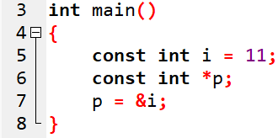
Solution:

Slide 40
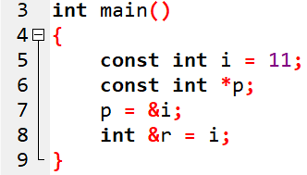
Question-3
Error !

Slide 41
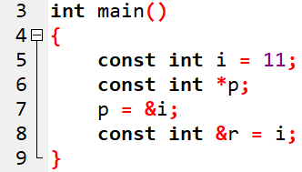
Solution:

